Slide 1
Database troubleshooting guide
RFK Library LIBGuides

Slide 2
Having problems with getting into databases from home, within campus, or office?
Here are some tips to try before you contact us:
Access databases through our website
Check your username and password
Check your firewall or antivirus
Enable cookies for the site
Clear browser cache and cookies

Slide 3
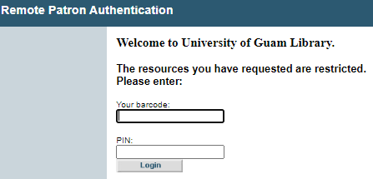
Access RFK Library Databases through the library website
RFK Database Subscriptions can only be accessed through RFK websites:
www.uog.edu/library
https://www.uog.edu/student-services/rfk-library/articles-and-databases
Do not try to access RFK databases through Google or through vendor sites
Database vendors require us to protect these databases by authenticating them on our website
Authentication is not needed when accessing these databases within the campus network (Eduroam and UOG workstations)
When off-campus you will see the following page:

Slide 4
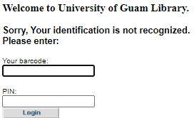
Check your barcode and pin
Ensure that your library barcode and PIN correct when:
You get “Your identification is not recognized” error
Do you have a valid, current University of Guam / RFK Memorial Library card?
Only University of Guam / RFK Memorial Library card cardholders are allowed access to these resources from outside the Library.
Did you enter your library card barcode number without any spaces?
When entering your number, make sure your Num Lock key is on and that you don't leave any spaces between the numbers.
You can contact the RFK Service Desk if you do not know your barcode and PIN at (671) 735 - 2311

Slide 5
Check your firewall or antivirus
Some internet security programs may require you to uncheck the advertising pop-up blockers and web blocking (e.g. McAfee) while others may require you to configure custom level privacy settings and disable browser privacy (e.g. Norton) in order to property use RFK database interfaces.
Settings and access to those settings vary by internet security product and version, so you should consult your software's user guide for more info.
Lookout for these signs when determining firewall or antivirus issues:
Norton, McAfee, or other antivirus program messages popup when trying to access our databases
Database pages do not load or has timeout errors

Slide 6
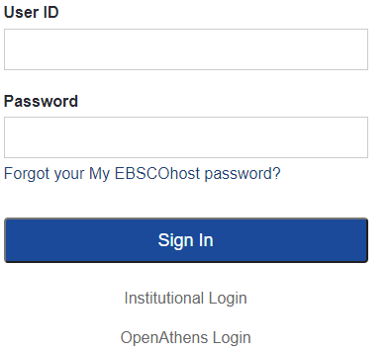
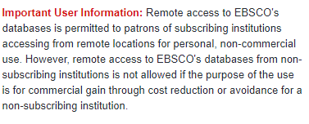
Enable cookies
In order for the databases to work properly, your web browser (Internet Explorer, Firefox, Safari, etc.) must be set to accept "cookies," which are temporary files that allow you to interact with secure web sites. For more information on cookies, see How Internet Cookies Work at this link: http://computer.howstuffworks.com/cookie1.htm .
Make sure cookies are enabled when:
Sites fails to load even after you have correctly inputted you barcode and PIN
The databases site requests a login for your university after you have successfully inputted your barcode and PIN

Slide 7
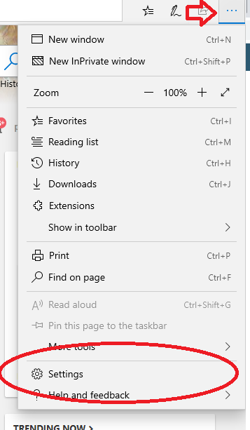
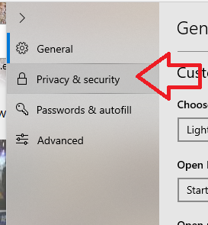
Enable cookies for Microsoft EDGE
Click “…” on the top-right of your window, select “Settings”.
Click on the "Privacy & Security" tab.
Finally, ensure that “Don’t Block Cookies” is selected under “Cookies”

Slide 8
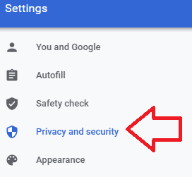
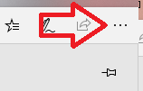
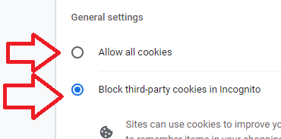
Enable cookies for google chrome
Click on the top-right of your window, select “Settings”.
Click on the "Privacy and Security"
Finally, ensure that either “Allow all cookies” or “Block third party cookies in Incognito” is selected under “General Settings”.

Slide 9
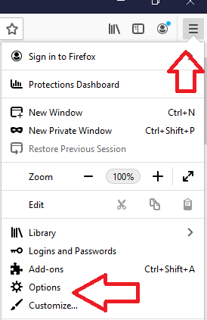
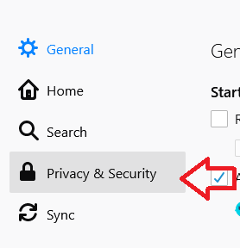
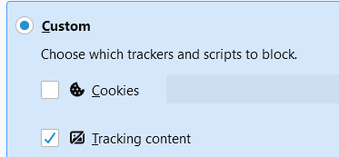
Enable cookies for Mozilla Firefox
Click on the top-right of your window, select “Options”.
Click on the "Privacy & Security"
Finally, ensure that either “Standard” or “Custom” (“Cookies” unchecked) is selected under “Enhanced Tracking Protection”.

Slide 10
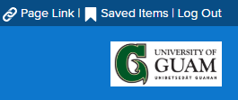
Clear your browser cache and cookies
Sometimes cookies and cached website files need to be re-downloaded because they are corrupt or old. In these cases, clearing your browser’s cache and cookies will force it to redownload new cookies and website files.
Clear your browser’s cache and cookies in the following situations:
The database site is incomplete or looks funny when loaded
The database site loads in another language
The database site does not show the UOG logo or shows the incorrect university

Slide 11
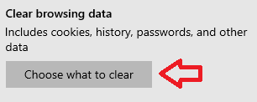
Delete cookies and Cache for Microsoft EDGE
Click “…” on the top-right of your window, select “Settings”.
Click on the "Privacy & Security" tab.
Click “Choose what to clear” is selected under “Clear browsing data”
Ensure “Browsing history” and “Cookies and saved website data” are selected
Finally, click “Clear”

Slide 12
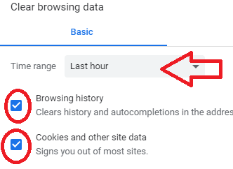
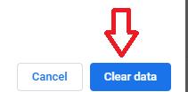
Delete cookies and Cache for google chrome
Click on the top-right of your window, select “Settings”.
Click on the "Privacy and Security"
Click “Clear browsing data”
Choose “Time range” (at least 24 hours)
Ensure that both “Browsing history” and “Cookies and other site data” is selected under “Basic”.
Finally, click “Clear data”

Slide 13
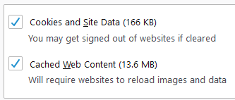
Delete cookies and Cache for Mozilla Firefox
Click on the top-right of your window, select “Options”.
Click on the "Privacy & Security"
Click “Clear Data…”
Ensure that both “cookies and Site Data” and “Cached Web Content”
Finally, click “Clear”

Slide 14
If nothing works, Please contact us
Please use the one of following contacts to report database issues and assistance:
Contact (671) 735-2321
Or (671) 735-2341
Or email jlibao@triton.uog.edu
Details, such as error messages and codes will greatly help solve database issues
If you have been able to access the databases in the past, but are unable to use a particular one now, the problem may not be yours, but could be with the database provider. Their server may be down temporarily for any number of reasons. Wait an hour and try it again. Report the issue if you still cannot access the database.
If you are given “Server” errors, please report to us immediately

