Slide 1
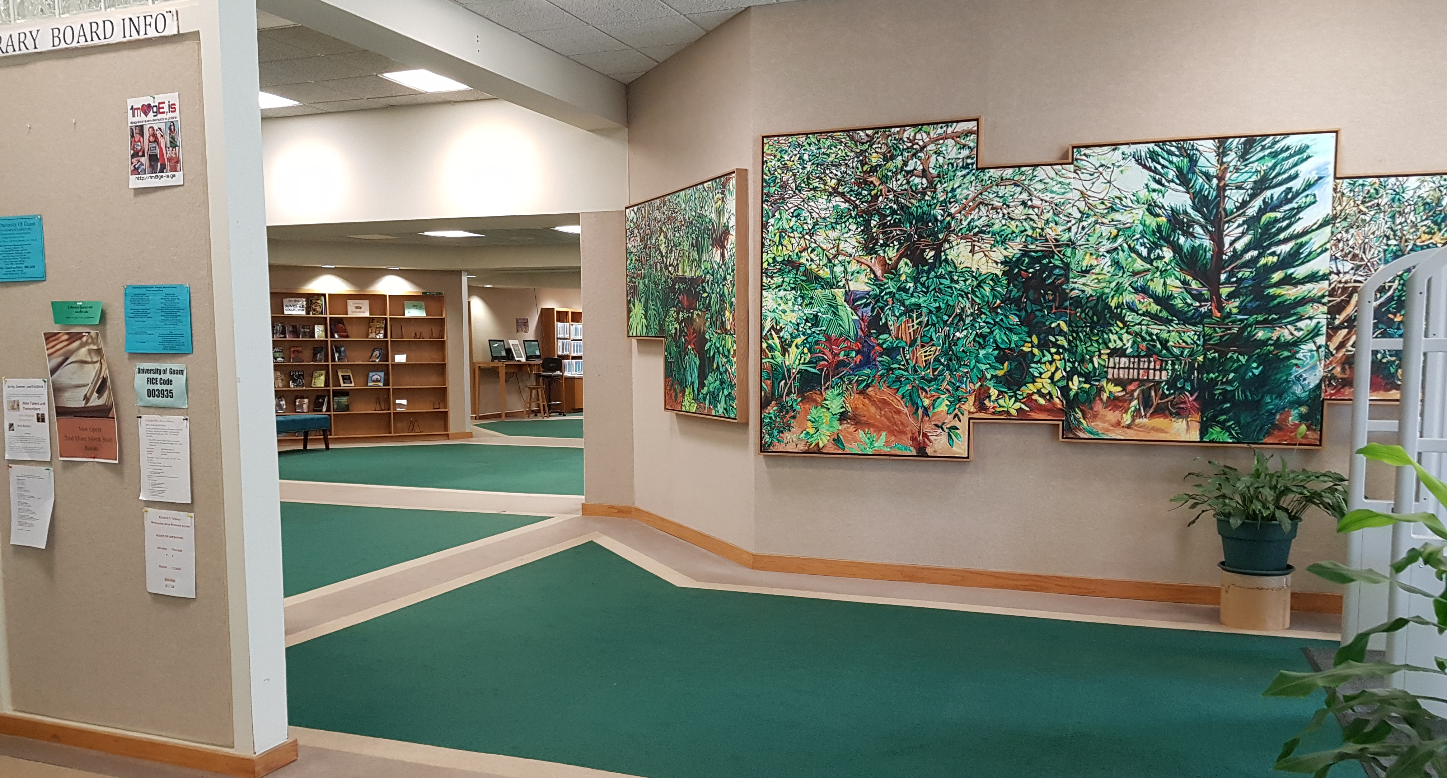
RFK Library Interlibrary Loan

Slide 2
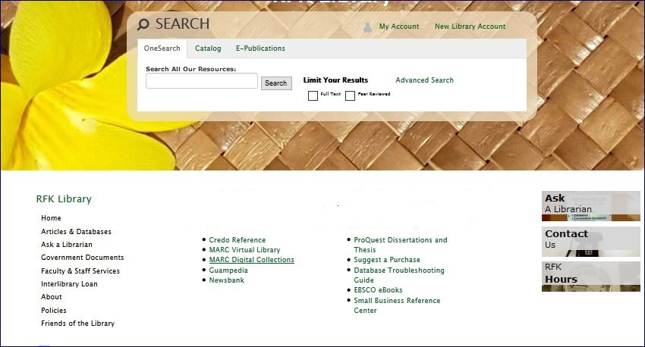
If you have already conducted a key word search using our Onesearch search bar, or databases, and are still unable to locate the needed information, seek help from your librarian.

Slide 3
An Interlibrary loan allows you to expand your resources by borrowing materials from other libraries. You can request for
journal articles
visual materials
Books
chapters of books

Slide 4
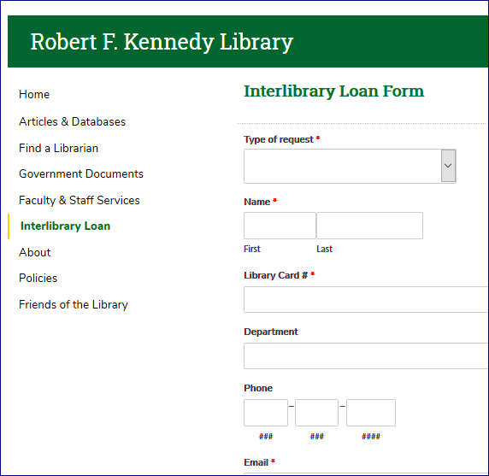
Fill out the form with the information to locate the materials you need. Keep in mind there may be additional costs associated like postage fees.

Slide 5
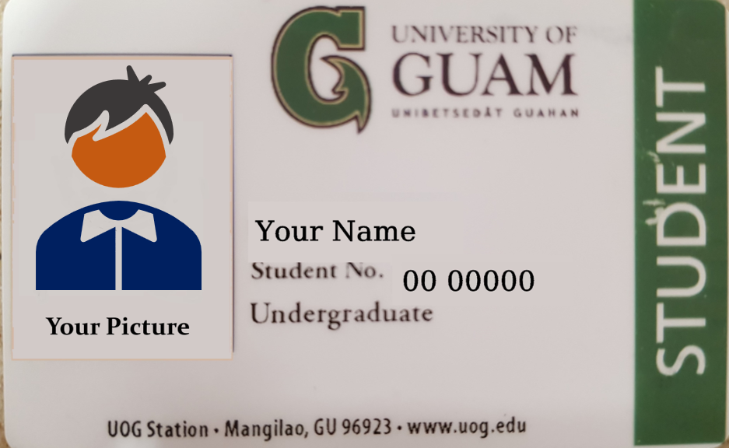
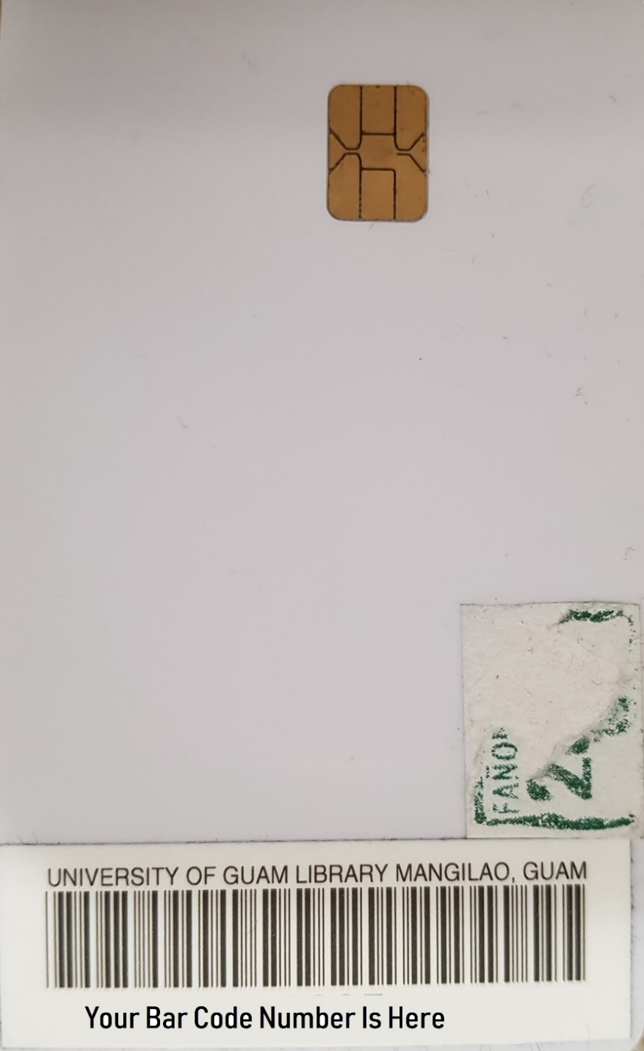
You will need your library card barcode number located on the back of your student I.D. and four-digit pin number to make the interlibrary loan request.

Slide 6
Thank you for looking to the RFK Library for assistance with your research needs.

