Slide 1
Requesting for digital MRF copies
RFK Library LIBGuides

Slide 2
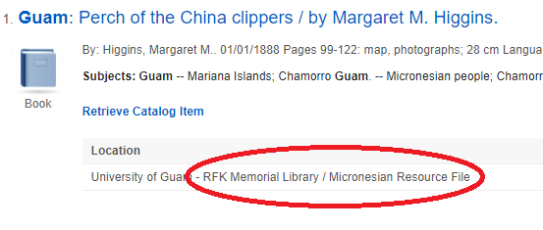
What is an MRF?
MRF stands for Micronesian Resource File
It is a special collection of stapled sheets stored in vertical file cabinets
These files mostly contain information on Guam and Micronesia
MRF files can be searched online through OneSearch and our OCEAN catalog
OneSearch
O. C. E. A. N. Catalog

Slide 3
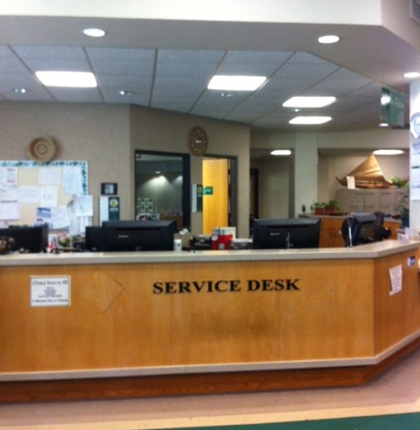
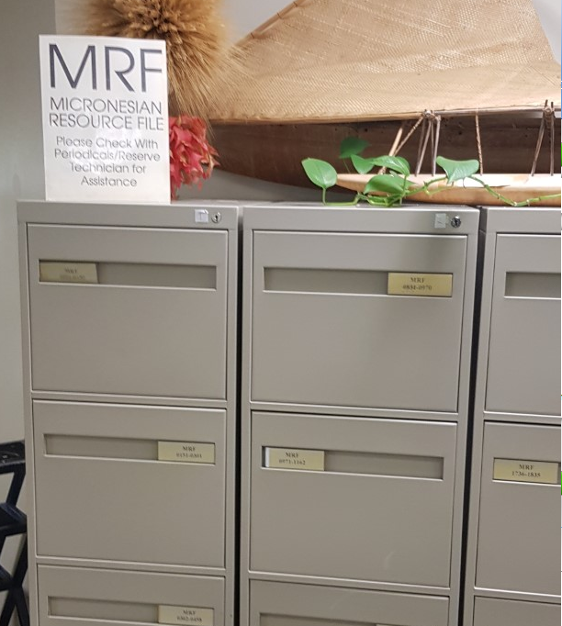
Accessing MRF files while at the library
In normal situations, it is very simple
Note down the call number and take it to the Service Desk
The technician will retrieve the file for you
The print version of the MRF file is only available within the library for 2 hours

Slide 4
When to request for digital mrf copies
Digital copies can be requested in emergency situations in which the RFK Library has to remain closed to patrons (eg. virus outbreak)

Slide 5
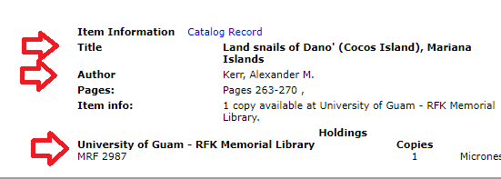
How to request for Digital MRF copies
Please send your request to the following email: uogcirc@triton.uog.edu
Or you can contact the Service desk @ (671) 735 – 2311
Please include the following information:
Call number
Author
Title of document
Copies will be sent to you via email

